Slide 1
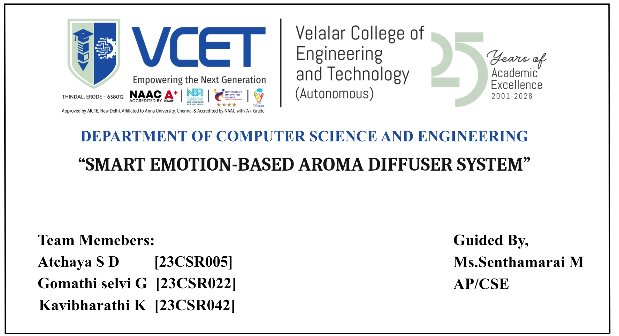

Slide 2
PROJECT DOMAIN
Artificial Intelligence (AI) & Deep Learning (DL):
Detects human emotions using facial expression analysis with a CNN model.
Embedded Systems:
Arduino UNO controls the aroma diffuser hardware through relay modules.
Internet of Things (IoT):
A network of interconnected devices that communicate and exchange data through the internet.

Slide 3
ABSTRACT
This project develops a smart system to detect human emotions using a CNN-based facial recognition model to reduce stress for emotional well-being.
Develop a web/mobile platform for emotion monitoring.
Maintain emotion history and generate analytical reports.
Provide AI-based personalized wellness recommendations.
Extend the system into an IoT-enabled smart wellness platform.

Slide 4
SCOPE
This system can be used in homes, offices, and relaxation spaces to support better mental well-being.
It provides automatic aroma release based on detected human emotions.
Reduces manual effort by controlling the diffuser automatically.
Can be extended with a mobile app for monitoring and control.
Supports future integration with IoT-based smart systems.

Slide 5
OBJECTIVE
To detect human emotions using a CNN-based facial recognition system and automatically control the aroma diffuser based on detected emotions.
To Create an interactive Emotion Analytics Dashboard.
To Store and manage emotion history securely.
To Generate personalized wellness recommendations.
To reduce stress and improve emotional balance using aroma therapy.
To design a simple, low-cost, and user-friendly system.

Slide 6
EXISTING SYSTEM
Hardware prototype successfully implemented.
CNN-based real-time emotion detection completed.
Automatic aroma diffuser control achieved.
No software dashboard for emotion analysis.
No cloud storage or user management.
Limited remote monitoring capabilities.

Slide 7
PROPOSED SYSTEM
Develop a user-friendly web/mobile application.
Display live emotion detection and system status.
Maintain user-wise emotion history.
Generate daily, weekly, and monthly emotion reports.
Implement AI-based wellness recommendations.
Prepare the software architecture for future IoT integration.

Slide 8
FUTURE ENHANCEMENT
Integration of mobile application for remote monitoring and control.
Implementation of AI- based personalized aroma recommendation system.
Addition of cloud database for storing emotion history.
Development of emotion analytics dashboard for mood tracking.
Extension to IoT-based smart home systems.

Slide 9
HARDWARE AND SOFTWARE REQUIREMENTS
Hardware | Software
Laptop / PC | Python
Webcam | TensorFlow / Keras
Arduino / ESP32 | OpenCV
16×2 I2C LCD | Flask
Relay Module | HTML / CSS / JavaScript
Aroma Diffuser / Mist Maker | SQLite
Smartphone | Cloud Database
Sensors | Arduino IDE / IoT Platform
Internet / Wi-Fi | CNN & Recommendation Logic

Slide 10
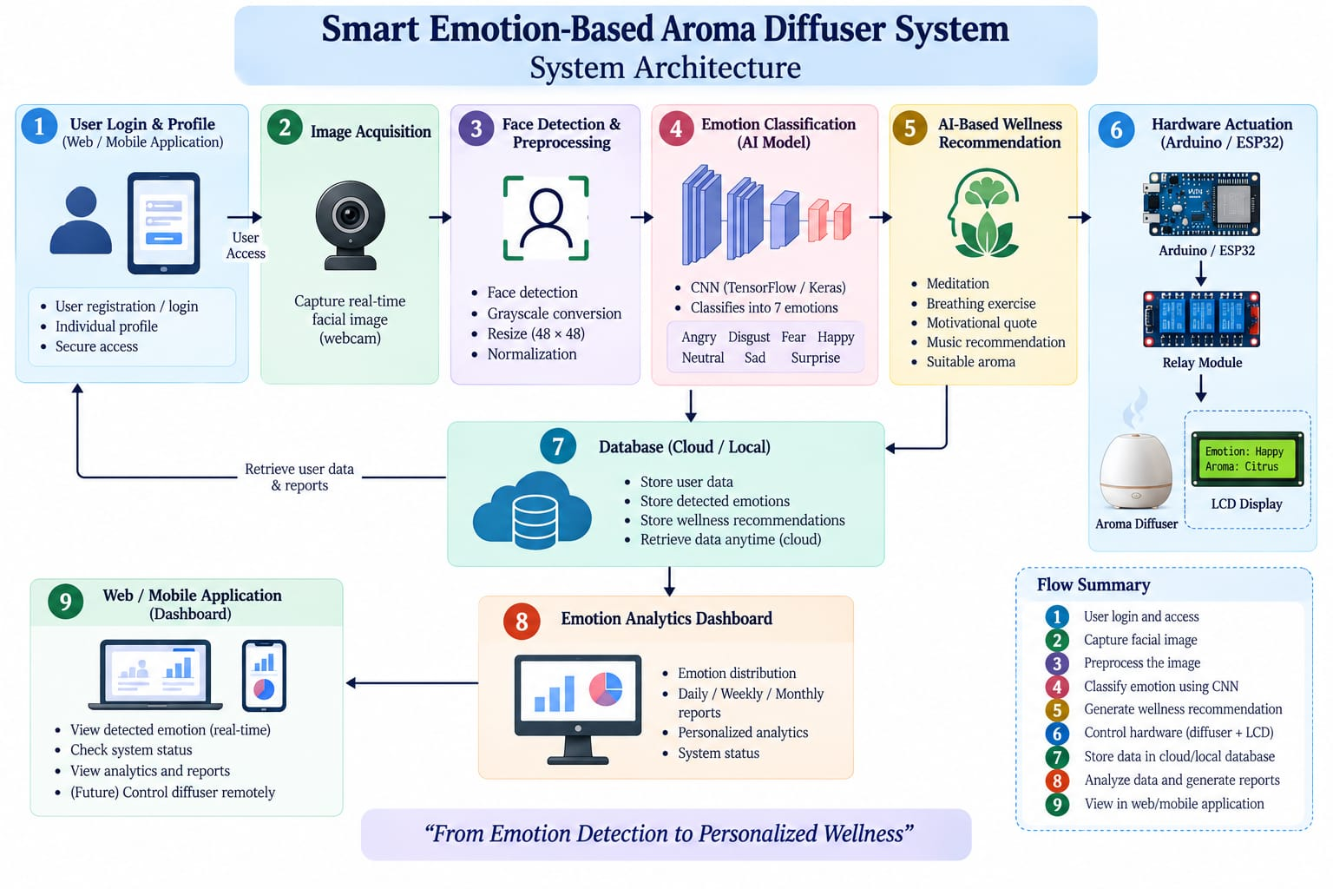

Slide 11
DESIGN AND IMPLEMENTATION
Module 1 — Emotion Analytics Dashboard
• CNN-based facial emotion detection processes live facial expressions.
• Emotion results from 10 frames are combined using majority voting for a stable emotion.
• The final emotion is stored in an SQLite database for user-wise history.
• Analytics converts stored emotion data into mood trends and daily/weekly/monthly reports.
• The dashboard displays current emotion, history, and analytical insights.

Slide 12
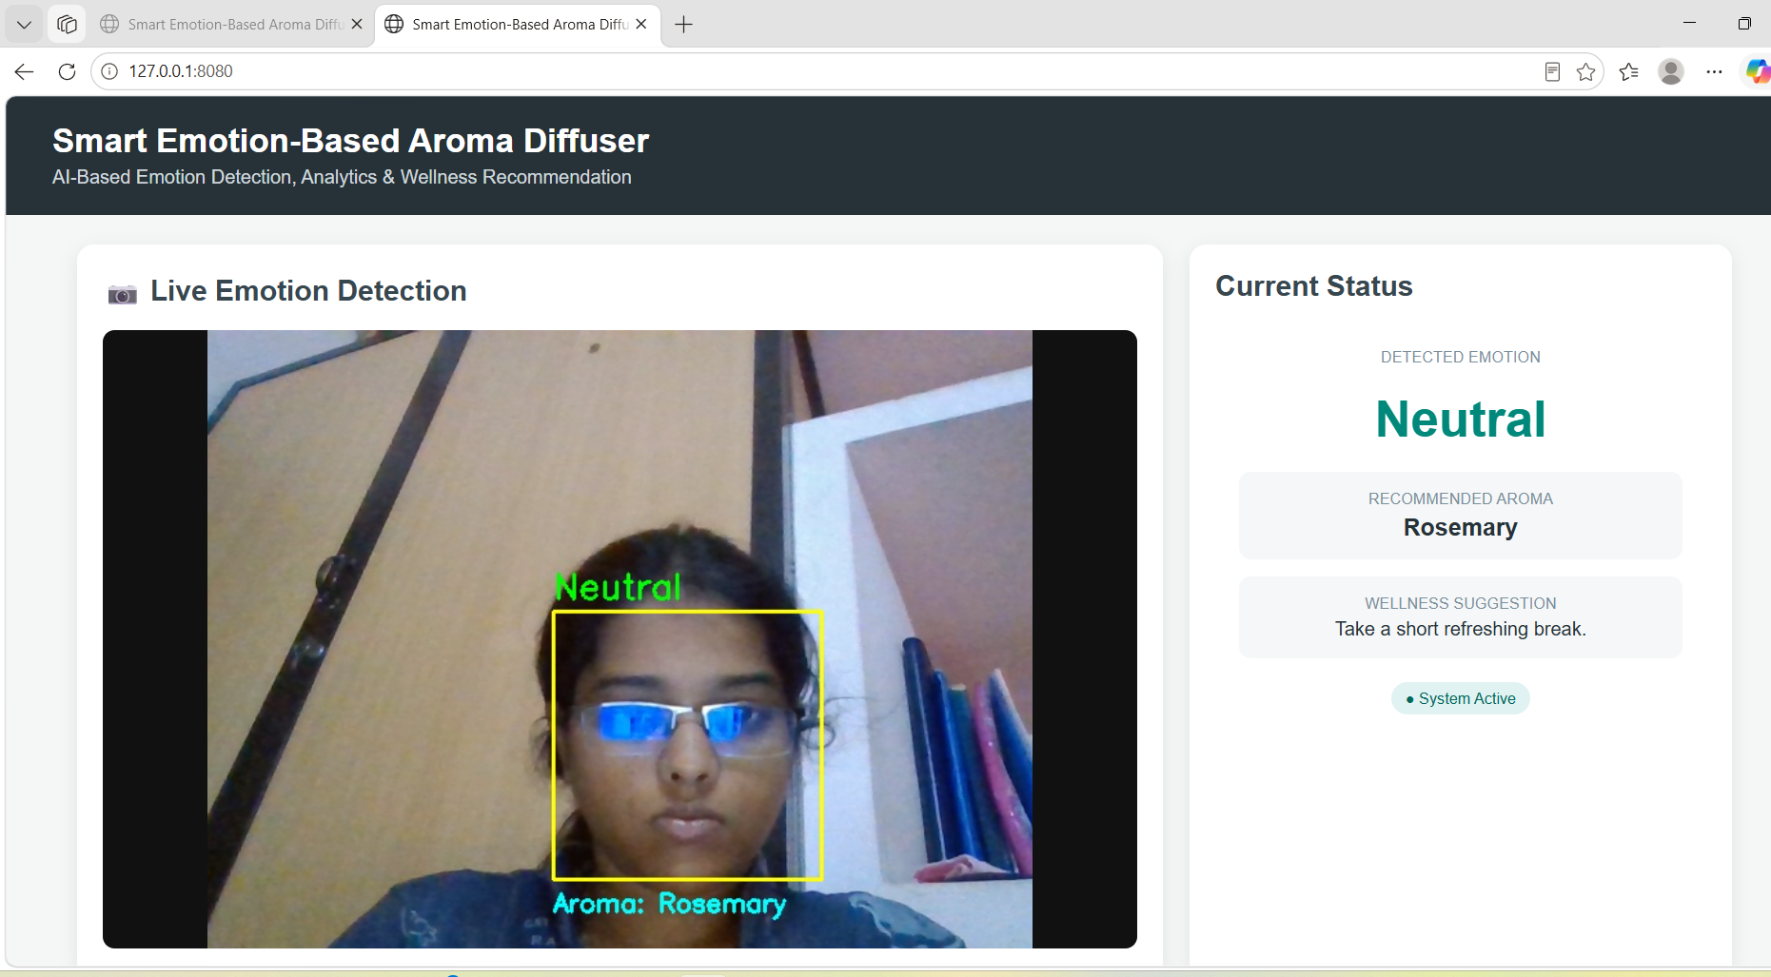
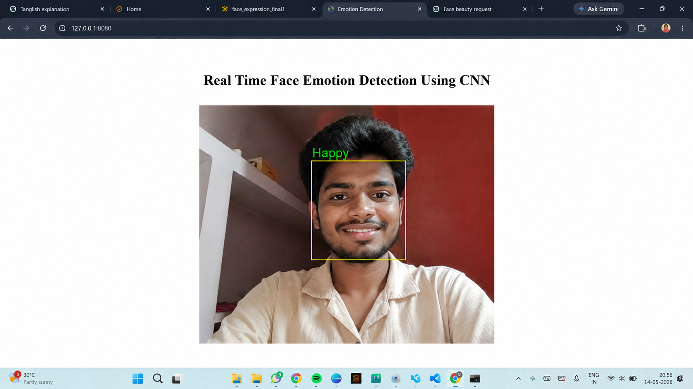

Slide 13
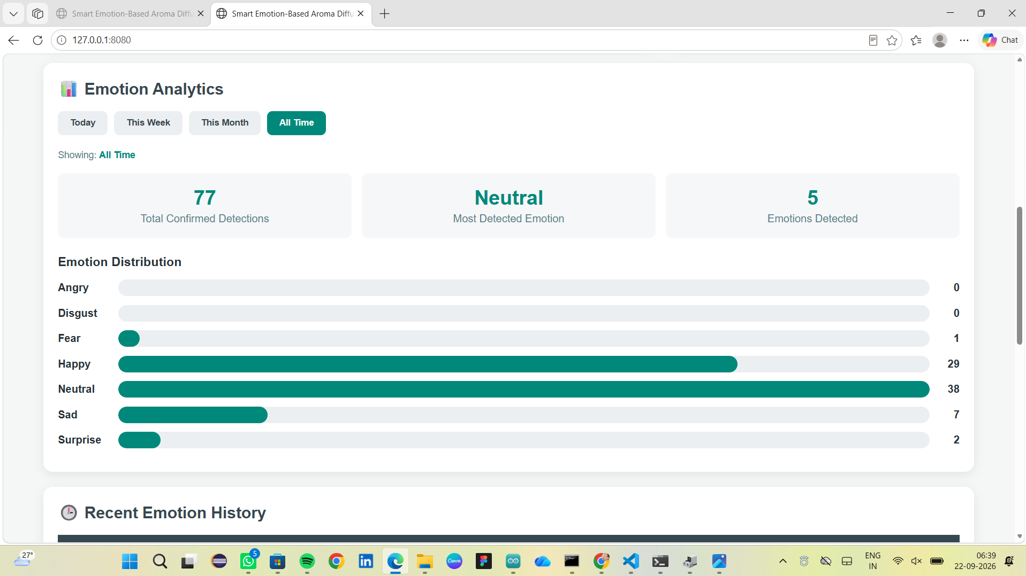
EMOTION ANALYTICS DASHBOARD

Slide 14
DESIGN AND IMPLEMENTATION
Module 2 — Wellness & Aroma Recommendation
• The majority emotion from Module 1 is passed to the recommendation engine.
• The system generates a personalized wellness recommendation based on the detected emotion.
• A suitable aroma suggestion is selected to support relaxation and emotional well-being.
• Arduino UNO receives the control signal and operates the aroma diffuser through the hardware interface.
• This module enables automatic, emotion-based aroma support with reduced manual effort.

Slide 15
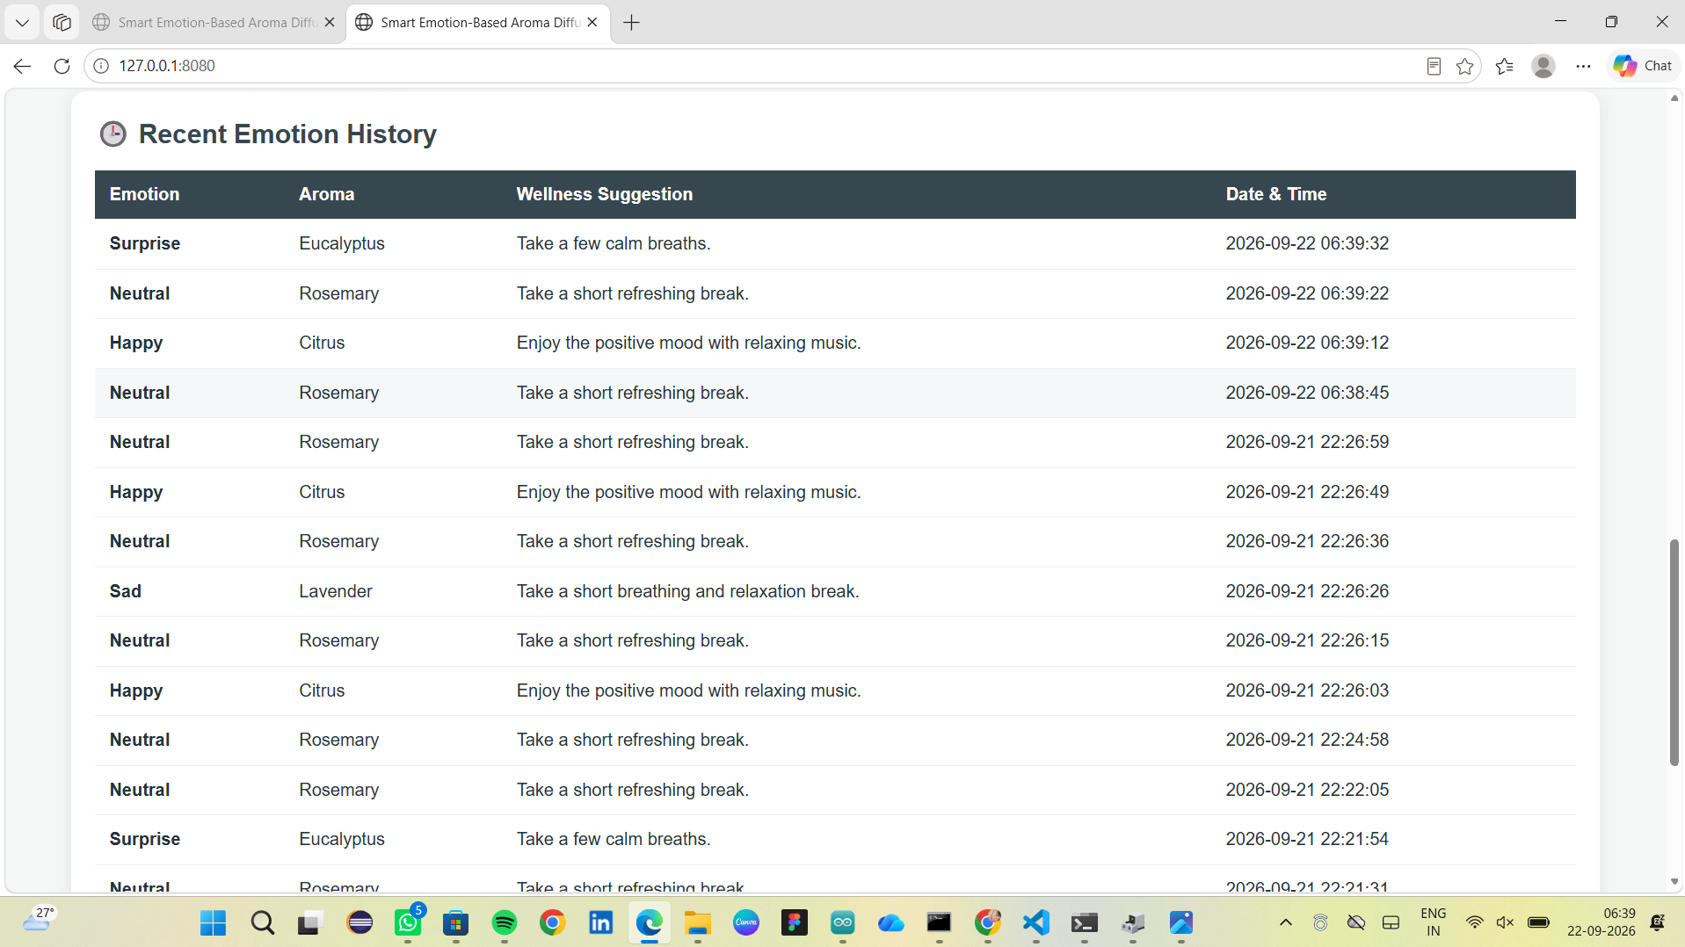
AI – BASED WELLNESS SUGGESTION

Slide 16
THANK YOU

